Slide 1
Nigeria Integrated Social Housing
Introduction

Slide 2

Table of Contents
Introduction
NISH Service Model
NISH Value Proposition
NISH Processes
Contact

Slide 3
Introduction

Slide 4
Introduction
NISH Housing promotes affordable housing delivery and provides opportunities for prospective home buyers, developers, partners, individual and group members.
Our strategic thrust covers:
Land bank for property development – through group land allocations
Provision of Site and services
Strategic partnerships with reputable property developer
Group discount from developers on houses in existing estates,
Syndication of offtakers' finance/credit line up to 70% of purchase price Securing housing finance single digit interest rate

Slide 5
NISH Service Model

Slide 6

Land,
Developers & Investors
Finance
Building
Materials Manufacturers
Utilities
Fund
Syndication
Consulting &
Capacity Building
Advocacy
Networking
Expert & Technical Skills
Research &
Statistics
Management
Legal/Policy Framework,
Infrastructure
Property Development & Marketing
Investment
Offtakers
Cooperatives
Building &
Technology Systems

Slide 7
NISH Value Proposition

Slide 8

NISH Value Proposition
Syndications
Match demand with ability to pay
Secure discounts
Ensure value for money
Support quality control
for affordable housing
Group negotiations
Construction innovation to lower costs
Provision of integrated housing communities
Quality
Financing
Affordability
Low cost credit

Slide 9
NISH Processes

Slide 10
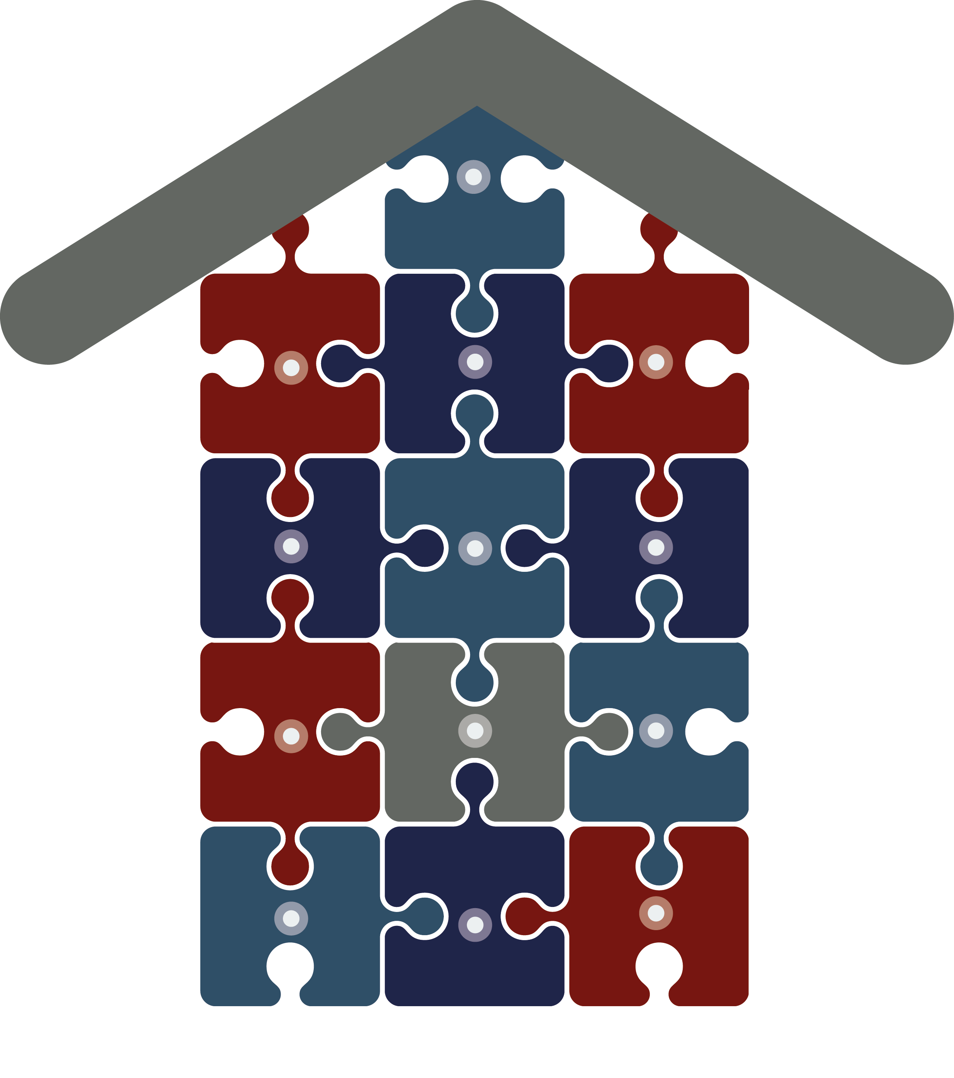
Off-Takers Guarantees
Land Acquisition
Housing Application & Allocation
Sites and Services
Application for
Mortgage Financing
Housing Development
Investment Opportunities
Infrastructure
Networking and
Knowledge Sharing
Financing
Advocacy
and Lobbying
Due Diligence
NISH Processes
Quality Assurance

Slide 11
Contact
Offices
Online
Nigeria Integrated Social Housing (NISH)
Plot 1138, Cadastral Zone B07,
(Opposite Grand Towers Hotel),
Katampe District,
Abuja
info@nishousing.com
08053882951
www.nishousing.com
www.housingfinance.ng

